Slide 1
Natural Language Processing Machine Translation
Sudeshna Sarkar
30 Aug 2019

Slide 2
History of Machine Translation (Based on work by John Hutchins, mt-archive.info)
Before the computer: In the mid 1930s, a French-Armenian Georges Artsrouni and a Russian Petr Troyanskii applied for patents for ‘translating machines’.
The pioneers (1947-1954): the first public MT demo was given in 1954 (by IBM and Georgetown University).
Machine translation was one of the first applications envisioned for computers

Slide 3
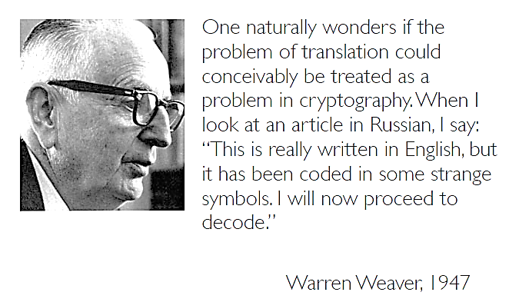
History of MT (2)
Warren Weaver, PhD was an American scientist, mathematician, and science administrator. He is widely recognized as one of the pioneers of machine translation, and as an important figure in creating support for science in the United States.

Slide 4
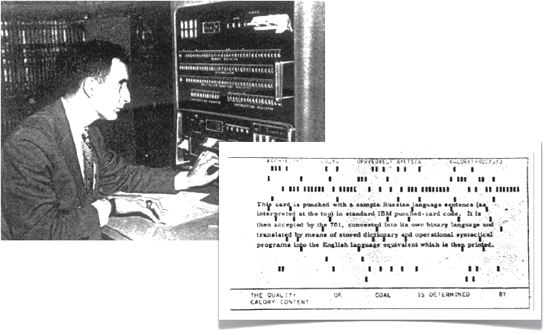
History of MT (3)
First demonstrated by IBM in 1954 with a basic word-for-word translation system

Slide 5
History of MT (4)
The decade of optimism (1954-1966) ended with the…
ALPAC (Automatic Language Processing Advisory Committee) report in 1966: “There is no immediate or predictable prospect of useful machine translation."

Slide 6

History of MT (5)
The ALPAC Report
The ALPAC (Automatic Language Processing Advisory Committee) was a govt. committee of seven scientists.
Their 1966 report was very skeptical of the progress in computational linguistics and machine translation.

Slide 7
History of MT (6)
The aftermath of the ALPAC report…
Research on machine translation virtually stopped from 1966 to 1980

Slide 8
History of MT (7)
Then, a rebirth…
The 1980s: Interlingua, example-based Machine Translation
The 1990s: Statistical MT
The 2000s: Hybrid MT
The 2010s: Google, real-time, mobile, Crowdsourcing, more hybrid approaches

Slide 9
What is Machine Translation?
Automatic conversion of text/speech from one natural language to another
e.g.
Be the change you want to see in the world
वह परिवर्तन बनो जो संसार में देखना चाहते हो
Google (Hindi): वह बदलाव बनें जो आप दुनिया में देखना चाहते हैं
Google (Bengali): পরিবর্তন আপনি বিশ্বের দেখতে চান
Google (Tamil): நீங்கள் உலகத்தில் பார்க்க விரும்பும் மாற்றமாக இருங்கள்
Google (Telugu): మీరు ప్రపంచంలో చూడాలనుకుంటున్న మార్పుగా ఉండండి

Slide 10
What is Machine Translation?
Automatic conversion of text/speech from one natural language to another
e.g.
Be the change you want to see in the world
वह परिवर्तन बनो जो संसार में देखना चाहते हो
Google (Hindi):
वह बदलाव बनें जो आप दुनिया में देखना चाहते हैं
Google (Bengali): পরিবর্তন আপনি বিশ্বের দেখতে চান
Google (Tamil): நீங்கள் உலகத்தில் பார்க்க விரும்பும் மாற்றமாக இருங்கள்
Google (Telugu): మీరు ప్రపంచంలో చూడాలనుకుంటున్న మార్పుగా ఉండండి

Slide 11
What is Machine Translation?
Automatic conversion of text/speech from one natural language to another
e.g.
Be the change you want to see in the world
वह परिवर्तन बनो जो संसार में देखना चाहते हो
Google (Hindi): आप दुनिया में जो बदलाव देखना चाहते हैं, वह बनें
Google (Bengali): আপনি বিশ্বের পরিবর্তন দেখতে চান হন
Google (Tamil): உலகில் நீங்கள் காண விரும்பும் மாற்றமாக இருங்கள்
Google (Telugu): మీరు ప్రపంచంలో చూడాలనుకుంటున్న మార్పుగా ఉండండి

Slide 12
Why study machine translation?
One of the most challenging problems in Natural Language Processing
Pushes the boundaries of NLP
Involves analysis as well as synthesis
Involves all layers of NLP: morphology, syntax, semantics, pragmatics, discourse
Theory and techniques in MT are applicable to a wide range of other problems like transliteration, speech recognition and synthesis

Slide 13
Why is machine translation difficult?
Language Divergence: the great diversity among languages of the world
Word order: SOV (Hindi), SVO (English), VSO, OSV,
Free (Sanskrit) vs rigid (English) word order
Analytic (Chinese) vs Polysynthetic (Finnish) languages
Different ways of expressing same concept
Case marking systems
Language registers
Inflectional systems [infixing (Arabic), fusional (Sanskrit), agglutinative (Marathi)]
… and much more

Slide 14
Why is machine translation difficult?
Ambiguity
Same word, multiple meanings:
Same meaning, multiple words: जल, पानी,नीर (water)
Word Order
Underlying deeper syntactic structure
Phrase structure grammar?
Computationally intensive
Morphological Richness
Identifying basic units of words

Slide 15
Machine Translation
Automatically translate one natural language into another.
Mary didn’t slap the green witch.
Maria no dió una bofetada a la bruja verde.

Slide 16
Word Alignment
Shows mapping between words in one language and the other.
Mary didn’t slap the green witch.
Maria no dió una bofetada a la bruja verde.

Slide 17
How do human translate languages?
Is a bilingual dictionary sufficient?
John loves Mary.
John told Mary a story.
Jean aime Marie.
Jean a raconté une histoire à Marie.
John is a computer scientist.
John swam across the lake.
Jean est informaticien.
Jean a traversé le lac à la nage.

Slide 18
Correspondences
One-to-one
John = Jean, aime = loves, Mary=Marie
One-to-many/many-to-one
Mary = [à Marie]
[a computer scientist] = informaticien
Many-to-many
[swam across __] = [a traversé __ à la nage]
Reordering required
told Mary¹ [a story]² = a raconté [une histoire]² [à Marie]¹
A bilingual dictionary is clearly insufficient!

Slide 19
Ambiguity Resolution is Required for Translation
Syntactic and semantic ambiguities must be properly resolved for correct translation:
“John plays the guitar.” → “John toca la guitarra.”
“John plays soccer.” → “John juega el fútbol.”
An apocryphal story is that an early MT system gave the following results when translating from English to Russian and then back to English:
“The spirit is willing but the flesh is weak.” ⇒ “The liquor is good but the meat is spoiled.”
“Out of sight, out of mind.” ⇒ “Invisible idiot.”

Slide 20
Lexical divergences
Different senses of homonymous words generally have different translations
Different senses of polysemous words may also have different translations
English - German
(river) bank - Ufer
(financial) bank - Bank
I know that he bought the book: Je sais qu’il a acheté le livre.
I know Peter: Je connais Peter.
I know math: Je m’y connais en maths.

Slide 21
Lexical Gaps
Some words in one language do not have a corresponding term in the other.
Rivière (river that flows into ocean) and fleuve (river that does not flow into ocean) in French
Schedenfraude (feeling good about another’s pain) in German.
Oyakoko (filial piety) in Japanese

Slide 22
Syntactic divergences
Word order
SVO (Sbj-Verb-Obj), SOV, VSO,…
fixed or free?
Head-marking vs. dependent-marking
Dependent-marking (English): the man’s house
Head-marking (Hungarian): the man house-his
Pro-drop languages can omit pronouns
Italian (with inflection): I eat = mangio; he eats = mangia
Chinese (without inflection): I/he eat: chīfàn

Slide 23
Semantic divergences
Aspect
English has a progressive aspect
‘Peter swims’ vs. ‘Peter is swimming’
German can only express this with an adverb:
‘Peter schwimmt’ vs. ‘Peter schwimmt gerade’
Clearly, a bilingual dictionary is insufficient; and machine translation is difficult!

Slide 24
Linguistic Issues Making MT Difficult
Morphological issues with agglutinative, fusion and polysynthetic languages with complex word structure.
Syntactic variation between SVO (e.g. English), SOV (e.g. Hindi), and VSO (e.g. Arabic) languages.
SVO languages use prepositions
SOV languages use postpositions
Pro-drop languages regularly omit subjects that must be inferred.

Slide 25
Taxonomy of MT systems
MT approaches
Knowledge-based:
Rule-based MT
Data Driven:
Machine Learning based MT
Interlingua based
Transfer based
Example-based MT
Statistical Machine Translation

Slide 26
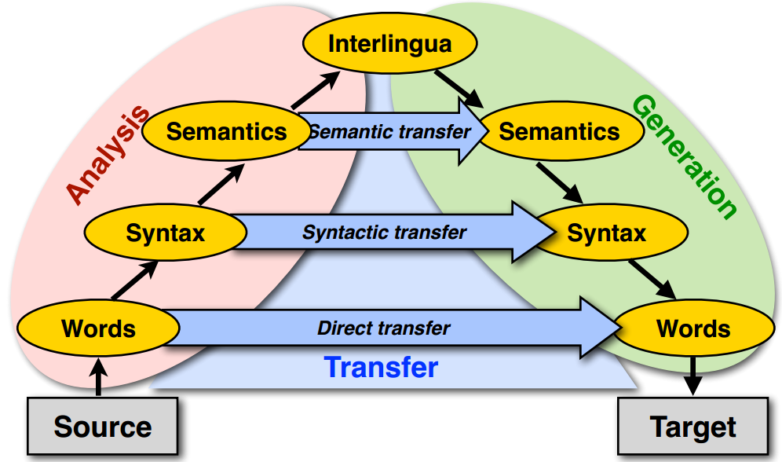
Machine translation approaches
The Vauquois triangle

Slide 27
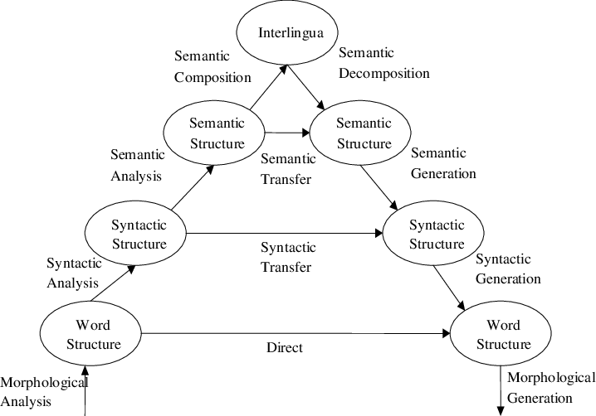
Vauquois Triangle

Slide 28
Direct Transfer
Morphological Analysis
Mary didn’t slap the green witch. →
Mary DO:PAST not slap the green witch.
Lexical Transfer
Mary DO:PAST not slap the green witch.
Maria no dar:PAST una bofetada a la verde bruja.
Lexical Reordering
Maria no dar:PAST una bofetada a la bruja verde.
Morphological generation
Maria no dió una bofetada a la bruja verde.

Slide 29
Syntactic Transfer
Simple lexical reordering does not adequately handle more dramatic reordering such as that required to translate from an SVO to an SOV language.
Need syntactic transfer rules that map parse tree for one language into one for another.
English to Spanish:
NP → Adj Nom ⇒ NP → Nom ADJ
English to Japanese:
VP → V NP ⇒ VP → NP V
PP → P NP ⇒ PP → NP P

Slide 30
Semantic Transfer
Some transfer requires semantic information.
Semantic roles can determine how to properly express information in another language.
In Chinese, PPs that express a goal, destination, or benefactor occur before the verb but those expressing a recipient occur after the verb.
Transfer Rule
English to Chinese
VP → V PP[+benefactor] ⇒ VP → PP[+benefactor] V

Slide 31
Statistical MT
Manually encoding comprehensive bilingual lexicons and transfer rules is difficult.
SMT acquires knowledge needed for translation from a parallel corpus or bitext that contains the same set of documents in two languages.
First align the sentences in the corpus based on simple methods that use coarse cues like sentence length to give bilingual sentence pairs.

Slide 32
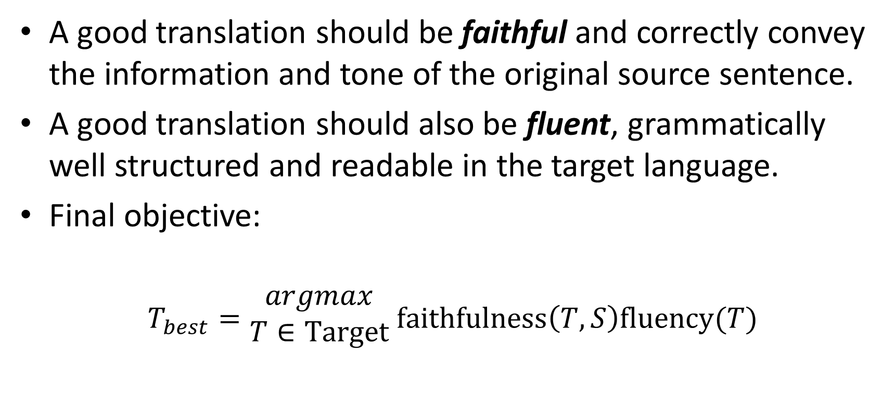
Picking a Good Translation
A good translation should be faithful and correctly convey the information and tone of the original source sentence.
A good translation should also be fluent, grammatically well structured and readable in the target language.
Final objective:
$$T_{best}=\begin{matrix}argmax \\ T∈Target\end{matrix} faithfulness\left(T,S\right)fluency(T)$$

Slide 33
Noisy Channel Model
Based on analogy to information-theoretic model used to decode messages transmitted via a communication channel that adds errors.
Assume that source sentence was generated by a “noisy” transformation of some target language sentence and then use Bayesian analysis to recover the most likely target sentence that generated it.
e
Noisy Channel
f
Translate foreign language sentence
F=f₁, f₂, …f_{m}
to an English sentence
Ȇ = e₁, e₂, …e_{I}
that maximizes P(E | F)
Task is to recover e from noisy f.
P(F|E): Translation model
P(E): Language model

Slide 34
Bayesian Analysis of Noisy Channel
A decoder determines the most probable
translation Ȇ given F
Translation Model Language Model
Source
Transmitter
(encoder)
Noisy
Channel
Receiver
(decoder)
Destination
Eng
Fre
Eng’
P(Eng)
P(Fre|Eng)
P(Eng’|Fre)=?
Language model
Translation model
Observation
Guessed input

Slide 35
Language Model
Use a standard n-gram language model for P(E) or ..
Can be trained on a large, unsupervised mono-lingual corpus for the target language E.

Slide 36
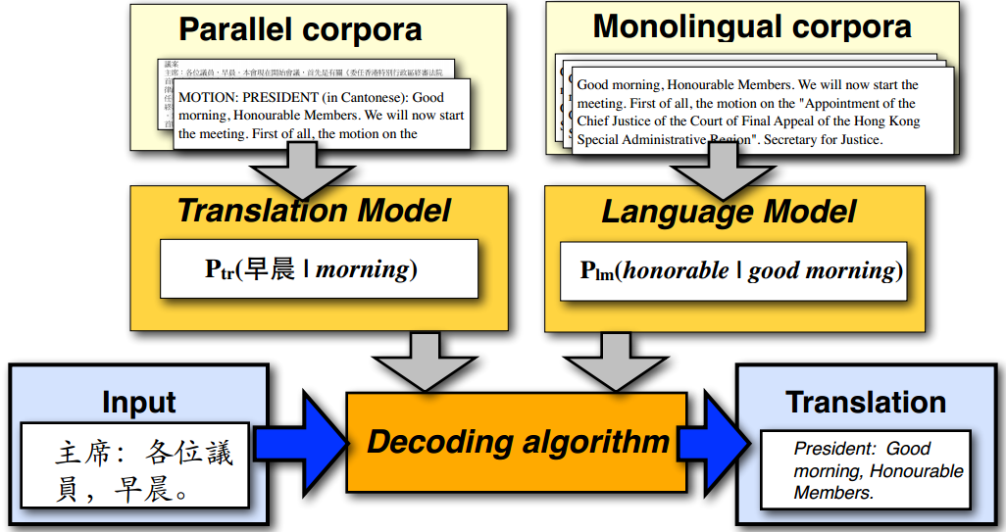
Statistical machine translation

Slide 37
IBM translation models
A generative model based on noisy channel framework
Generate the translation sentence e with regard to the given sentence f by a stochastic process
Generate the length of f
Generate the alignment of e to the target sentence f
Generate the words of f
$$Eng^{∗}=argmax_{Eng}p\left(Fre | Eng\right)p(Eng)$$

Slide 38
Word Alignment
Directly constructing phrase alignments is difficult, so rely on first constructing word alignments.
Can learn to align from supervised word alignments, but human-aligned bitexts are rare and expensive to construct.
Typically use an unsupervised EM-based approach to compute a word alignment from unannotated parallel corpus.

Slide 39
Word alignment
One to one, one to many and reordering
John told Mary a story.
Jean a raconté une histoire à Marie.
Target sentence
 | Jean | a | raconté | une | histoire | à | Marie
John
told
Mary
a
story
Source sentence

Slide 40
Word alignment
Many to one and missing word
John swam across the lake.
Jean a traversé le lac à la nage.
Target sentence
A special symbol
 | Jean | a | traversé | le | lac | à | la | nage
NULL
John
swam
across
the
lake
Source sentence

Slide 41
Representing word alignments
Alignment table
 |  | 1 | 2 | 3 | 4 | 5 | 6 | 7 | 8
 |  | Jean | a | traversé | le | lac | à | la | nage
0 | NULL
1 | John
2 | swam
3 | across
4 | the
5 | lake
Target Position | 1 | 2 | 3 | 4 | 5 | 6 | 7 | 8
Source Position | 1 | 3 | 3 | 4 | 5 | 0 | 0 | 2

Slide 42
One to Many Alignment
To simplify the problem, typically assume each word in F aligns to 1 word in E (but assume each word in E may generate more than one word in F).
Some words in F may be generated by the NULL element of E.
Therefore, alignment can be specified by a vector A giving, for each word in F, the index of the word in E which generated it.

Slide 43
IBM Model 1
First model proposed in seminal paper by Brown et al. in 1993 as part of CANDIDE, the first complete SMT system.
Assumes following simple generative model of producing F from E=e₁, e₂, …e_{I}
Choose length, J, of F sentence: F=f₁, f₂, …f_{J}
Choose a 1 to many alignment A=a₁, a₂, …a_{J}
For each position in F, generate a word f_{j} from the aligned word in E: e_{aj}

Slide 44

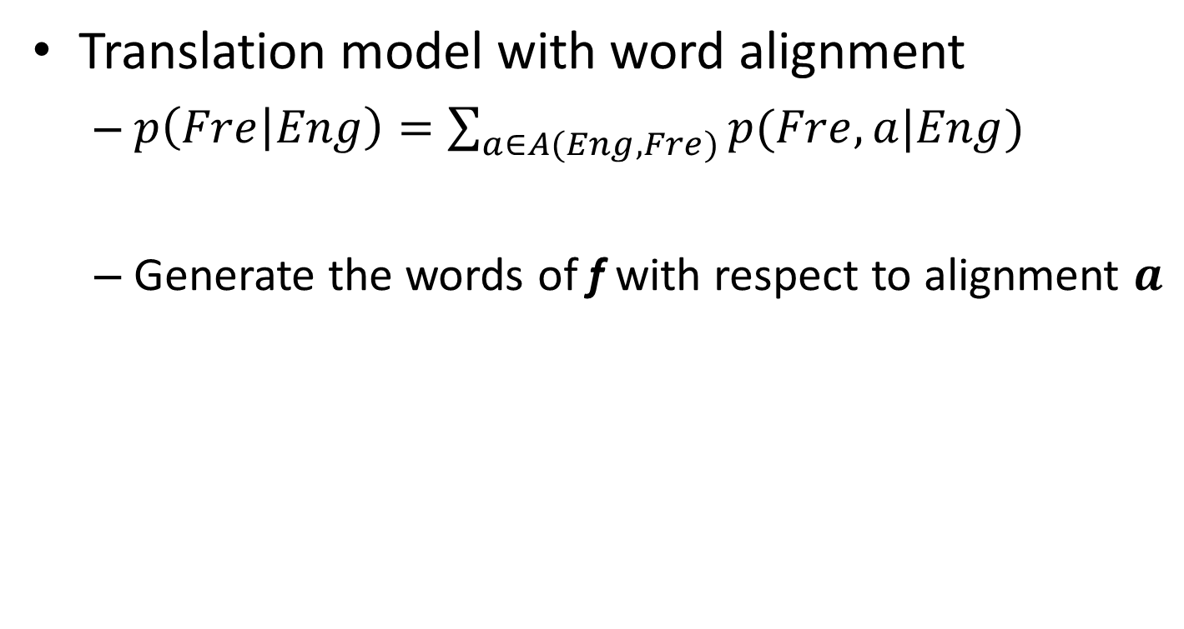


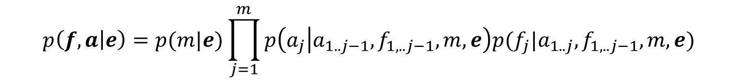
IBM translation models
Translation model with word alignment
$p\left(Fre | Eng\right)=\sum_{a∈A(Eng,Fre)}{p(Fre,a|Eng)}$
Generate the words of f with respect to alignment $a$
marginalize over all possible alignments $a$
$$p\left(f,a | e\right)=p(m|e)\prod_{j=1}^{m}{p\left(a_{j} | a_{1..j−1},f_{1,..j−1},m,e\right)p(f_{j}|a_{1..j},f_{1,..j−1},m,e)}$$
Length of target sentence f
Word alignment $a_{j}$
Translation of $f_{j}$

Slide 45
IBM translation models
Sequence of 5 translation models
Different assumptions and realization of the components in the translation models, i.e., length model, alignment model and translation model
Model 1 is the simplest and becomes the basis of follow-up IBM translation models

Slide 46
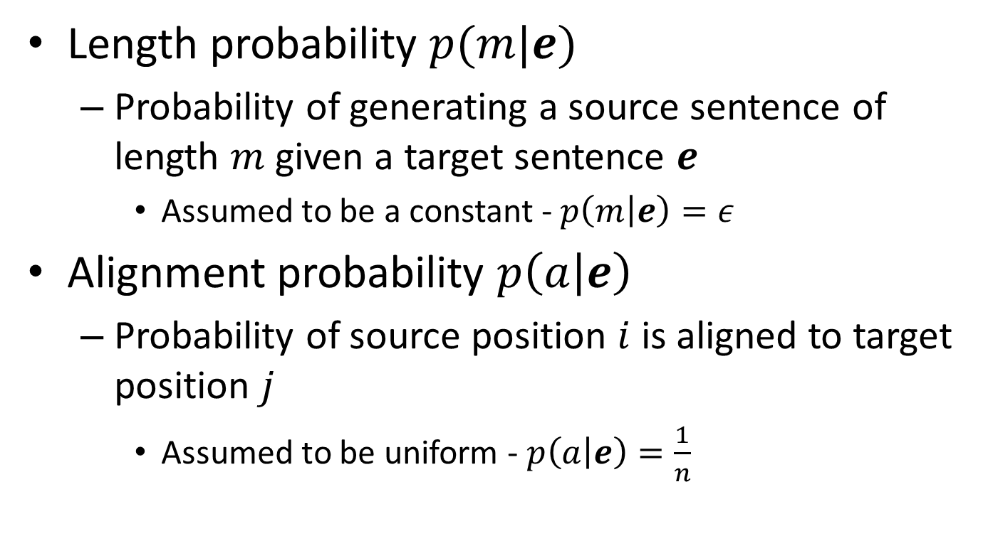
Parameters in Model 1
Length probability $p(m|e)$
Probability of generating a source sentence of length $m$ given a target sentence $e$
Assumed to be a constant - $p\left(m | e\right)=ε$
Alignment probability $p\left(a | e\right)$
Probability of source position $i$ is aligned to target position $j$
Assumed to be uniform - $p\left(a | e\right)=\frac{1}{n}$
length of source sentence

Slide 47
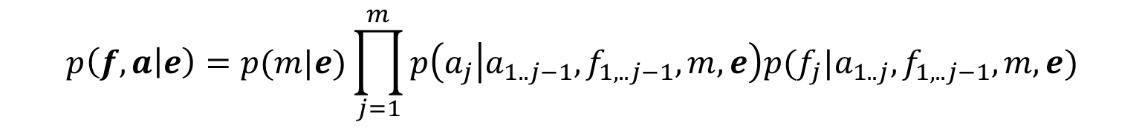
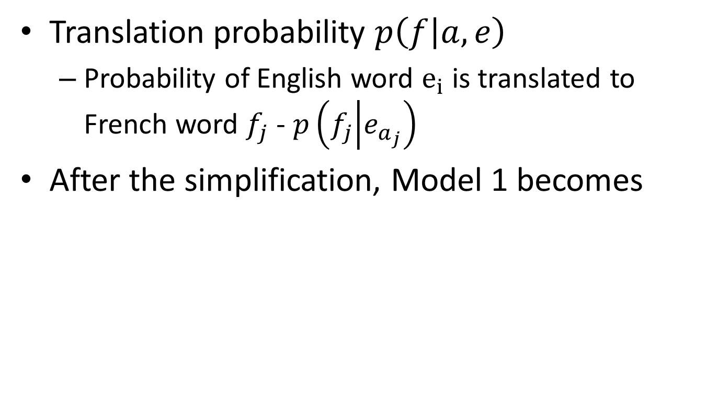
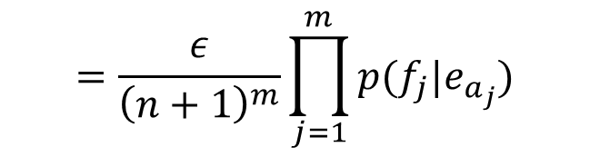
Parameters in Model 1
Translation probability $p\left(f | a,e\right)$
Probability of English word $e_{i}$ is translated to French word $f_{j}$ - $p\left(f_{j} | e_{a_{j}}\right)$
After the simplification, Model 1 becomes
$$p\left(f,a | e\right)=p(m|e)\prod_{j=1}^{m}{p\left(a_{j} | a_{1..j−1},f_{1,..j−1},m,e\right)p(f_{j}|a_{1..j},f_{1,..j−1},m,e)}$$
$$=\frac{ε}{{\left(n+1\right)}^{m}}\prod_{j=1}^{m}{p(f_{j}|e_{a_{j}})}$$
We add a NULL word in the source sentence

Slide 48
Recap: IBM translation models
Translation model with word alignment
$p\left(Fre | Eng\right)=\sum_{a∈A(Eng,Fre)}{p(Fre,a|Eng)}$
Generate the words of f with respect to alignment $a$
marginalize over all possible alignments $a$
$$p\left(f,a | e\right)=p(m|e)\prod_{j=1}^{m}{p\left(a_{j} | a_{1..j−1},f_{1,..j−1},m,e\right)p(f_{j}|a_{1..j},f_{1,..j−1},m,e)}$$
Length of target sentence f
Word alignment $a_{j}$
Translation of $f_{j}$

Slide 49
Generative process in Model 1
For a particular English sentence $e = e_{1}..e_{n}$ of length $n$
0 | 1 | 2 | 3 | 4 | 5
NULL | John | swam | across | the | lake
Source
1. Choose a length $m$ for the target sentence (e.g m = 8)
1 | 2 | 3 | 4 | 5 | 6 | 7 | 8
? | ? | ? | ? | ? | ? | ? | ?
Order of action
2. Choose an alignment $a= a_{1}…a_{m}$for the source sentence
Target Position | 1 | 2 | 3 | 4 | 5 | 6 | 7 | 8
Source Position | 1 | 3 | 3 | 4 | 5 | 0 | 0 | 2
Transmitter
3. Translate each source word $e_{a_{j}}$into the target language
English | John | across | across | the | lake | NULL | NULL | swam
Alignment | 1 | 3 | 3 | 4 | 5 | 0 | 0 | 2
Encoded | Jean | a | traversé | le | lac | à | la | nage

Slide 50
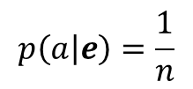


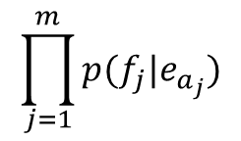

Decoding process in Model 1
$$p\left(e | f\right)=1e^{−55}$$
For a particular English sentence $e = e_{1}..e_{n}$ of length $n$
$$p(e)$$
0 | 1 | 2 | 3 | 4 | 5
NULL | John | flies | across | the | river
Search through all English sentences
1. Choose a length $m$ for the target sentence (e.g m = 8)
1 | 2 | 3 | 4 | 5 | 6 | 7 | 8
? | ? | ? | ? | ? | ? | ? | ?
Search through all possible alignments
$$p\left(m | e\right)=ε$$
2. Choose an alignment $a= a_{1}…a_{m}$for the source sentence
Order of action
$$p\left(a | e\right)=\frac{1}{n}$$
Target Position | 1 | 2 | 3 | 4 | 5 | 6 | 7 | 8
Source Position | 1 | 2 | 4 | 5 | 5 | 2 | 0 | 3
$$\prod_{j=1}^{m}{p(f_{j}|e_{a_{j}})}$$
3. Translate each source word $e_{a_{j}}$into the target language
English | John | flies | the | river | river | flies | NULL | across
Alignment | 1 | 2 | 4 | 5 | 5 | 2 | 0 | 3
Encoded | Jean | a | traversé | le | lac | à | la | nage
Receiver

Slide 51

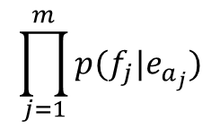

Decoding process in Model 1
$$p\left(e | f\right)=1e^{−15}$$
For a particular English sentence $e = e_{1}..e_{n}$ of length $n$
0 | 1 | 2 | 3 | 4 | 5
NULL | John | swam | across | the | lake
Search through all English sentences
$$p(e)$$
1. Choose a length $m$ for the target sentence (e.g m = 8)
1 | 2 | 3 | 4 | 5 | 6 | 7 | 8
? | ? | ? | ? | ? | ? | ? | ?
Search through all possible alignments
$$p\left(m | e\right)=ε$$
2. Choose an alignment $a= a_{1}…a_{m}$for the source sentence
Order of action
$$p\left(a | e\right)=\frac{1}{n}$$
Target Position | 1 | 2 | 3 | 4 | 5 | 6 | 7 | 8
Source Position | 1 | 3 | 3 | 4 | 5 | 0 | 0 | 2
$$\prod_{j=1}^{m}{p(f_{j}|e_{a_{j}})}$$
3. Translate each source word $e_{a_{j}}$into the target language
English | John | across | across | the | lake | NULL | NULL | swam
Alignment | 1 | 3 | 3 | 4 | 5 | 0 | 0 | 2
Encoded | Jean | a | traversé | le | lac | à | la | nage
Receiver

Slide 52
Decoding process in Model 1
Search space is huge
Presumably all “sentences” in English
English sentence length is unknown
All permutation of words in the vocabulary
Heuristics to reduce search space
Trade-off between translation accuracy and efficiency

Slide 53

Alignments
The generative process explains only one way of generating a sentence pair
Each way corresponds to an alignment
Total probability of the sentence pair is the sum of probability over all alignments
Input: Parallel sentences 1…S in languages E and F
But alignments are not known
Goal: Learn the model P(f|e)

Slide 54
Estimation of translation probability
If we do not have ground-truth word-alignments, appeal to Expectation Maximization algorithm
Intuitively, guess the alignment based on the current translation probability first; and then update the translation probability

Slide 55
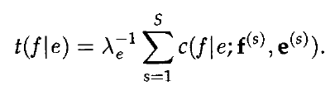
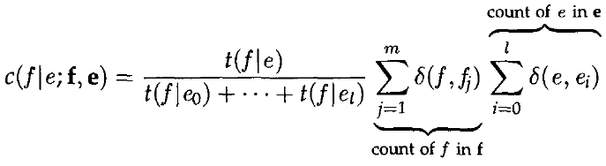

Training Algorithm
c(f|e) is the expected count that f and e are aligned
Initialize all t(f|e) to any value in [0,1].
Repeat the E-step and M-step till t(f|e) values converge
E-Step
M-Step
for each sentence in training corpus
for each f,e pair : Compute c(f|e;f(s),e(s))
Use t(f|e) values from previous iteration
for each f,e pair: compute t(f|e)
Use the c(f|e) values computed in E-step

Slide 56
Other translation models
IBM models 2-5 are more complex
Word order and string position of the aligned words
Phase-based translation in the source and target languages
Incorporate syntax or quasi-syntactic structures
Greatly reduce search space

Slide 57
What you should know
Challenges in machine translation
Lexicon/syntactic/semantic divergences
Statistical machine translation
Source-channel framework for statistical machine translation
Generative process
IBM model 1
Idea of word alignment

Slide 58
Sample IBM Model 1 Generation
0 1 2 3 4 5 6
NULL Mary didn’t slap the green witch.
Maria
no
dió
una
bofetada
a
la
bruja
verde.
1 2 3 3 3 0 4 6 5

Slide 59
Computing P(F | E) in IBM Model 1
Assume some length distribution P(J | E)
Assume all alignments are equally likely. Since there are (I + 1)^{J} possible alignments:
Assume t(f_{x},e_{y}) is the probability of translating e_{y} as f_{x}, therefore:
Determine P(F | E) by summing over all alignments:

Slide 60
Decoding for IBM Model 1
Goal is to find the most probable alignment given a parameterized model.
Since translation choice for each position j is independent,
the product is maximized by maximizing each term:

Slide 61
HMM-Based Word Alignment
IBM Model 1 assumes all alignments are equally likely and does not take into account locality:
If two words appear together in one language, then their translations are likely to appear together in the result in the other language.
An alternative model of word alignment based on an HMM model does account for locality by making longer jumps in switching from translating one word to another less likely.

Slide 62
HMM Model
Assumes the hidden state is the specific word occurrence e_{i} in E currently being translated (i.e. there are I states, one for each word in E).
Assumes the observations from these hidden states are the possible translations f_{j} of e_{i.}
Generation of F from E then consists of moving to the initial E word to be translated, generating a translation, moving to the next word to be translated, and so on.

Slide 63
Sample HMM Generation
1 2 3 4 5 6
Mary didn’t slap the green witch.
Maria

Slide 64
Sample HMM Generation
1 2 3 4 5 6
Mary didn’t slap the green witch.
Maria
no

Slide 65
Sample HMM Generation
1 2 3 4 5 6
Mary didn’t slap the green witch.
Maria
no
dió

Slide 66
Sample HMM Generation
1 2 3 4 5 6
Mary didn’t slap the green witch.
Maria
no
dió
una

Slide 67
Sample HMM Generation
1 2 3 4 5 6
Mary didn’t slap the green witch.
Maria
no
dió
una
bofetada

Slide 68
Sample HMM Generation
1 2 3 4 5 6
Mary didn’t slap the green witch.
Maria
no
dió
una
bofetada
a

Slide 69
Sample HMM Generation
1 2 3 4 5 6
Mary didn’t slap the green witch.
Maria
no
dió
una
bofetada
a
la

Slide 70
Sample HMM Generation
1 2 3 4 5 6
Mary didn’t slap the green witch.
Maria
no
dió
una
bofetada
a
la
bruja

Slide 71
Sample HMM Generation
1 2 3 4 5 6
Mary didn’t slap the green witch.
Maria
no
dió
una
bofetada
a
la
bruja
verde.

Slide 72
Sample HMM Generation
1 2 3 4 5 6
Mary didn’t slap the green witch.
Maria
no
dió
una
bofetada
a
la
bruja
verde.

Slide 73
HMM Parameters
Transition and observation parameters of states for HMMs for all possible source sentences are “tied” to reduce the number of free parameters that have to be estimated.
Observation probabilities: b_{j}(f_{i})=P(f_{i} | e_{j}) the same for all states representing an occurrence of the same English word.
State transition probabilities: a_{ij} = s(j−i) the same for all transitions that involve the same jump width (and direction).

Slide 74
Computing P(F | E) in the HMM Model
Given the observation and state-transition probabilities, P(F | E) (observation likelihood) can be computed using the standard forward algorithm for HMMs.
74
Notes:
74

Slide 75
Decoding for the HMM Model
Use the standard Viterbi algorithm to efficiently compute the most likely alignment (i.e. most likely state sequence).
75
Notes:
75

Slide 76
Training Word Alignment Models
Both the IBM model 1 and HMM model can be trained on a parallel corpus to set the required parameters.
For supervised (hand-aligned) training data, parameters can be estimated directly using frequency counts.
For unsupervised training data, EM can be used to estimate parameters, e.g. Baum-Welch for the HMM model.

Slide 77
Sketch of EM Algorithm for Word Alignment
Randomly set model parameters.
(making sure they represent legal distributions)
Until converge (i.e. parameters no longer change) do:
E Step: Compute the probability of all possible
alignments of the training data using the current
model.
M Step: Use these alignment probability estimates to
re-estimate values for all of the parameters.
Note: Use dynamic programming (as in Baum-Welch)
to avoid explicitly enumerating all possible alignments
77
Notes:
77

Slide 78
Sample EM Trace for Alignment (IBM Model 1 with no NULL Generation)
Training
Corpus
green house
casa verde
the house
la casa
verde casa la
green
1/3 | 1/3 | 1/3
1/3 | 1/3 | 1/3
1/3 | 1/3 | 1/3
Translation
Probabilities
Assume uniform
initial probabilities
house
the
Compute
Alignment
Probabilities
P(A, F | E)
green house
casa verde
green house
casa verde
the house
la casa
the house
la casa
1/3 X 1/3 = 1/9
1/3 X 1/3 = 1/9
1/3 X 1/3 = 1/9
1/3 X 1/3 = 1/9
Normalize
to get
P(A | F, E)

Slide 79
Example cont.
green house
casa verde
green house
casa verde
the house
la casa
the house
la casa
1/2
1/2
1/2
1/2
verde casa la
Compute
weighted
translation
counts
green
1/2 | 1/2 | 0
1/2 | 1/2 + 1/2 | 1/2
0 | 1/2 | 1/2
house
the
verde casa la
Normalize
rows to sum
to one to
estimate P(f | e)
green
1/2 | 1/2 | 0
1/4 | 1/2 | 1/4
0 | 1/2 | 1/2
house
the

Slide 80
Example cont.
verde casa la
green
1/2 | 1/2 | 0
1/4 | 1/2 | 1/4
0 | 1/2 | 1/2
Translation
Probabilities
house
the
Recompute
Alignment
Probabilities
P(A, F | E)
green house
casa verde
green house
casa verde
the house
la casa
the house
la casa
1/2 X 1/4=1/8
1/2 X 1/2=1/4
1/2 X 1/2=1/4
1/2 X 1/4=1/8
Normalize
to get
P(A | F, E)
Continue EM iterations until translation
parameters converge

Slide 81
Decoding
Goal is to find a translation that maximizes the product of the translation and language models.
Cannot explicitly enumerate and test the combinatorial space of all possible translations.
The optimal decoding problem for all reasonable model’s (e.g. IBM model 1) is NP-complete.
Heuristically search the space of translations using A*, beam-search, etc. to approximate the solution to this difficult optimization problem.

Slide 82
Evaluating MT
Human subjective evaluation is the best but is time-consuming and expensive.
Automated evaluation comparing the output to multiple human reference translations is cheaper and correlates with human judgements.

Slide 83
Human Evaluation of MT
Ask humans to estimate MT output on several dimensions.
Fluency: Is the result grammatical, understandable, and readable in the target language.
Fidelity: Does the result correctly convey the information in the original source language.
Adequacy: Human judgment on a fixed scale.
Bilingual judges given source and target language.
Monolingual judges given reference translation and MT result.
Informativeness: Monolingual judges must answer questions about the source sentence given only the MT translation (task-based evaluation).

Slide 84
Computer-Aided Translation Evaluation
Edit cost: Measure the number of changes that a human translator must make to correct the MT output.
Number of words changed
Amount of time taken to edit
Number of keystrokes needed to edit

Slide 85
Automatic Evaluation of MT
Collect one or more human reference translations of the source.
Compare MT output to these reference translations.
Score result based on similarity to the reference translations.
BLEU
NIST
TER
METEOR

Slide 86
BLEU
Determine number of n-grams of various sizes that the MT output shares with the reference translations.
Compute a modified precision measure of the n-grams in MT result.

Slide 87
BLEU Example
Cand 1: Mary no slap the witch green
Cand 2: Mary did not give a smack to a green witch.
Ref 1: Mary did not slap the green witch.
Ref 2: Mary did not smack the green witch.
Ref 3: Mary did not hit a green sorceress.
Cand 1 Unigram Precision: 5/6

Slide 88
BLEU Example
Cand 1: Mary no slap the witch green.
Cand 2: Mary did not give a smack to a green witch.
Ref 1: Mary did not slap the green witch.
Ref 2: Mary did not smack the green witch.
Ref 3: Mary did not hit a green sorceress.
Cand 1 Bigram Precision: 1/5

Slide 89
BLEU Example
Cand 1: Mary no slap the witch green.
Cand 2: Mary did not give a smack to a green witch.
Ref 1: Mary did not slap the green witch.
Ref 2: Mary did not smack the green witch.
Ref 3: Mary did not hit a green sorceress.
Clip match count of each n-gram to maximum
count of the n-gram in any single reference
translation
Cand 2 Unigram Precision: 7/10

Slide 90
BLEU Example
Cand 1: Mary no slap the witch green.
Cand 2: Mary did not give a smack to a green witch.
Ref 1: Mary did not slap the green witch.
Ref 2: Mary did not smack the green witch.
Ref 3: Mary did not hit a green sorceress.
Cand 2 Bigram Precision: 4/9

Slide 91
Modified N-Gram Precision
Average n-gram precision over all n-grams up to size N (typically 4) using geometric mean.
Cand 1:
Cand 2:

Slide 92
Brevity Penalty
Not easy to compute recall to complement precision since there are multiple alternative gold-standard references and don’t need to match all of them.
Instead, use a penalty for translations that are shorter than the reference translations.
Define effective reference length, r, for each sentence as the length of the reference sentence with the largest number of n-gram matches. Let c be the candidate sentence length.

Slide 93
BLEU Score
Final BLEU Score: BLEU = BP × p
Cand 1: Mary no slap the witch green.
Best Ref: Mary did not slap the green witch.
Cand 2: Mary did not give a smack to a green witch.
Best Ref: Mary did not smack the green witch.

Slide 94
BLEU Score Issues
BLEU has been shown to correlate with human evaluation when comparing outputs from different SMT systems.
However, it is does not correlate with human judgments when comparing SMT systems with manually developed MT (Systran) or MT with human translations.
Other MT evaluation metrics have been proposed that claim to overcome some of the limitations of BLEU.

Slide 95
Syntax-Based Statistical Machine Translation
Recent SMT methods have adopted a syntactic transfer approach.
Improved results demonstrated for translating between more distant language pairs, e.g. Chinese/English.

Slide 96
Synchronous Grammar
Multiple parse trees in a single derivation.
Used by (Chiang, 2005; Galley et al., 2006).
Describes the hierarchical structures of a sentence and its translation, and also the correspondence between their sub-parts.

Slide 97
Synchronous Productions
Has two RHSs, one for each language.
Chinese:
English:
X → X 是甚麼 / What is X

Slide 98
Syntax-Based MT Example
Input: 俄亥俄州的首府是甚麼？

Slide 99
Syntax-Based MT Example
X
X
Input: 俄亥俄州的首府是甚麼？

Slide 100
Syntax-Based MT Example
X
X
X 是甚麼
What is X
Input: 俄亥俄州的首府是甚麼？
X → X 是甚麼 / What is X

Slide 101
Syntax-Based MT Example
X
X
X 是甚麼
What is X
X 首府
the capital X
Input: 俄亥俄州的首府是甚麼？
X → X 首府 / the capital X

Slide 102
Syntax-Based MT Example
X
X
X 是甚麼
What is X
X 首府
the capital X
X 的
of X
Input: 俄亥俄州的首府是甚麼？
X → X 的 / of X

Slide 103
Syntax-Based MT Example
X
X
X 是甚麼
What is X
X 首府
the capital X
X 的
of X
俄亥俄州
Ohio
Input: 俄亥俄州的首府是甚麼？
X → 俄亥俄州 / Ohio

Slide 104
Syntax-Based MT Example
X
X
X 是甚麼
What is X
X 首府
the capital X
X 的
of X
俄亥俄州
Ohio
Input: 俄亥俄州的首府是甚麼？
Output: What is the capital of Ohio?

Slide 105
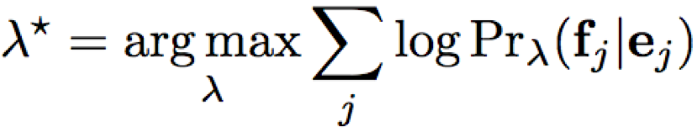
Synchronous Derivations and Translation Model
Need to make a probabilistic version of synchronous grammars to create a translation model for P(F | E).
Each synchronous production rule is given a weight λ_{i} that is used in a maximum-entropy (log linear) model.
Parameters are learned to maximize the conditional log-likelihood of the training data.

Slide 106
Neural Machine Translation (NMT)
Encoder/Decoder framework maps sentence in source language to a "deep vector" then another LSTM maps this vector to a sentence in the target language
Encoder
LSTM
Decoder
LSTM
F₁, F₂,…,F_{n}
h_{n}
E₁, E₂,…,E_{m}
Train model "end to end" on sentence-aligned parallel corpus.

Slide 107
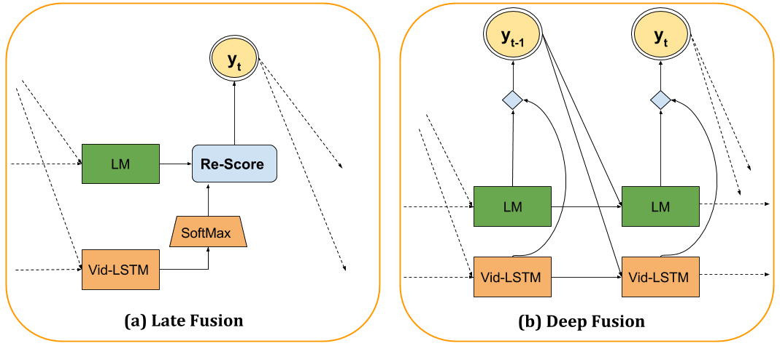
NMT with Language Model
Vanilla LSTM approach does not use a language model so does not exploit monolingual data for the target language.
Can integrate an LSTM language model using “deep fusion.”
Decoder predicts the next word from a concatenation of the hidden states of both the translation and language LSTM models.
Softmax
Concatenate
TM
TM

Slide 108
Conclusions
MT methods can usefully exploit various amounts of syntactic and semantic processing along the Vauquois triangle.
Statistical MT methods can automatically learn a translation system from a parallel corpus.
Typically use a noisy-channel model to exploit both a bilingual translation model and a monolingual language model.
Neural LSTM methods are currently the state-of-the-art.

